Slide 1
Scheduling Using a Lookahead Variant of the Heterogeneous Earliest Finish Time Algorithm
Luiz F. Bittencourt, Rizos Sakellariou and Edmundo R. M. Madeira
2010 18th Euromicro Conference on Parallel, Distributed and Network-based Processing, Pisa, 2010, pp. 27-34, doi: 10.1109/PDP.2010.56.
Presenter : Chih-Kai Wu
Date: Nov. 3, 2020.

Slide 2
Abstract
Among the numerous DAG scheduling heuristics suitable for heterogeneous systems, the Heterogeneous Earliest Finish Time (HEFT) heuristic is known to give good results in short time. In this paper, we propose an improvement of HEFT, where the locally optimal decisions
made by the heuristic do not rely on estimates of a single task only, but also look ahead in the schedule and take into account information about the impact of this decision to the children of the task being allocated. Preliminary simulation results indicate that the lookahead variation of HEFT can effectively reduce the makespan of the schedule in most cases without making the algorithm’s execution time prohibitively high.

Slide 3
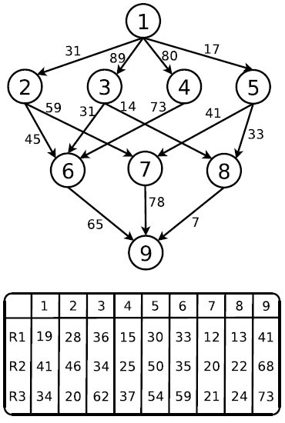
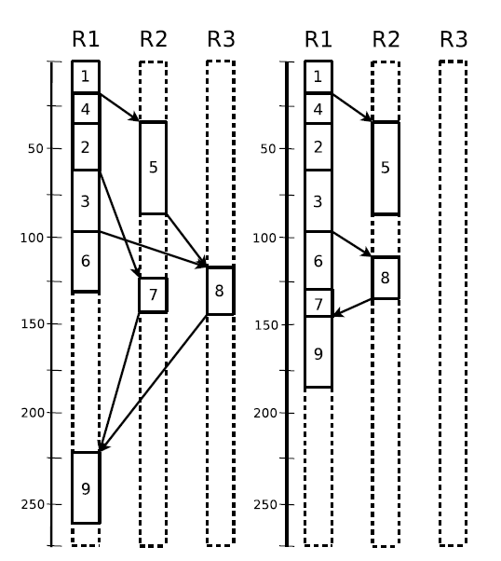
Task | Rank
1 | 378
4 | 266.67
2 | 246.67
3 | 243
5 | 242
6 | 168
7 | 156.33
8 | 87.33
9 | 60.67

Slide 4
R1 :
R1 = 19 + 28 + 36 + 15 =98
R2 = 19 + 17 + 50 = 86
R2 :
R2 = 41 + 25 + 46 = 112( > 86)
R3 :
R3 = 34+ 37 + 20 + 62 = 153 ( > 86)

Slide 5
R1 :
R1 = 19 + 15 + 28 + 36 + 33 + 12 + 41 = 184
R2 = 19 + 15 + 28 + 36 + 14 + 22 = 134
R2 :
R1 = 141 + 78 + 41 = 260
R2 = 62 + 59 + 20 = 141
R3 = 86 + 33 + 24 = 143
R3 :
R1 = 141 + 78 + 41 = 260
R2 = 98 + 14 + 22 = 134
R3 = 62 + 59 + 21 = 142

Slide 6
Task | Rank
1 | 378
4 | 266.67
2 | 246.67
3 | 243
5 | 242
6 | 168
7 | 156.33
8 | 87.33
9 | 60.67

Slide 7
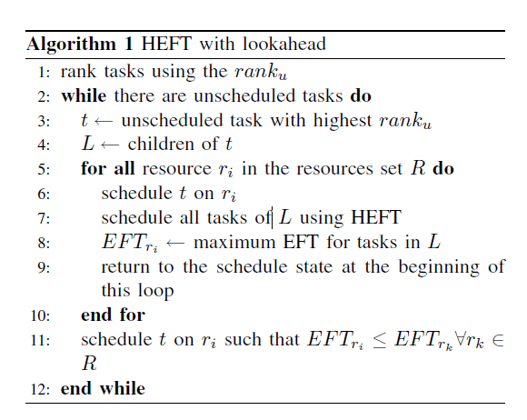
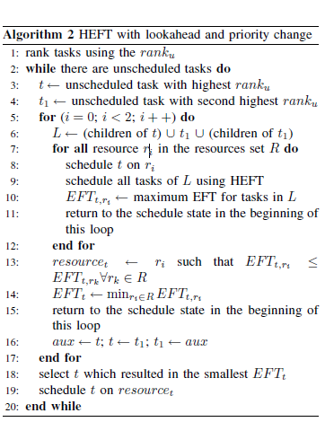

Slide 8
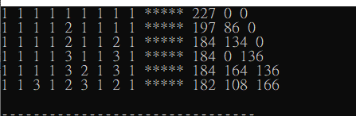
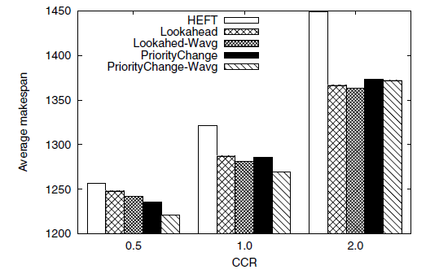

Slide 9
A Novel Heterogeneous Scheduling Algorithm with Improved Task Priority
Guan Wang, He Guo, Yuxin Wang
2015 IEEE 17th International Conference on High Performance Computing and Communications, 2015 IEEE 7th International Symposium on Cyberspace Safety and Security, and 2015 IEEE 12th International Conference on Embedded Software and Systems, New York, NY, 2015, pp. 1826-1831, doi: 10.1109/HPCC-CSS-ICESS.2015.48.
Presenter : Chih-Kai Wu
Date: Nov.3, 2020.

Slide 10
Abstract(1/2)
Efficient application scheduling algorithms are important to obtain high performance in heterogeneous computing systems. However, most of current algorithms are of low efficiency in scheduling. Aiming at this problem, we propose a heterogeneous scheduling algorithm with improved task priority (HSIP) whose functionality relies on two pillars: 1) a task priority strategy based on standard deviation and Communication Cost Weight to make scheduling priority more efficient; 2) an entry task duplication selection policy to make the makespan shorter and improve the idle time slot insertion-based.

Slide 11
Abstract(2/2)
We evaluate our roposed scheme on some real application DAGs by comparison with Predict Earliest Finish Time (PEFT), SD-Based Algorithm for Task Scheduling (SDBATS), Heterogeneous Earliest Finish Time (HEFT) and Critical Path On a Processor (CPOP). Experimental results show that our proposed scheme performs better than other algorithms in terms of schedule length ratio, speedup and
efficiency

Slide 12

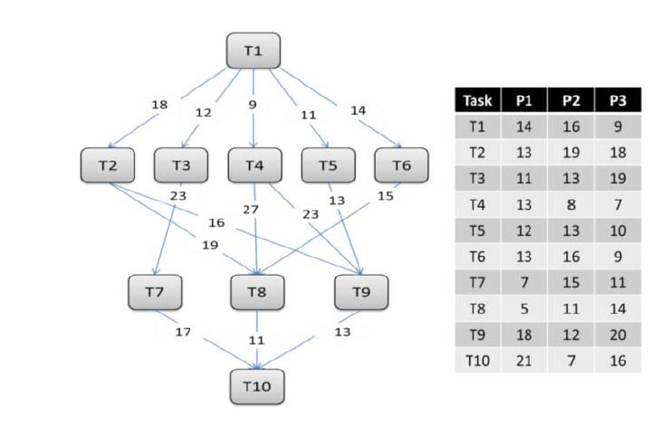
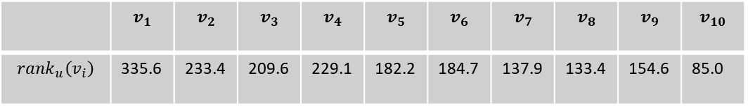
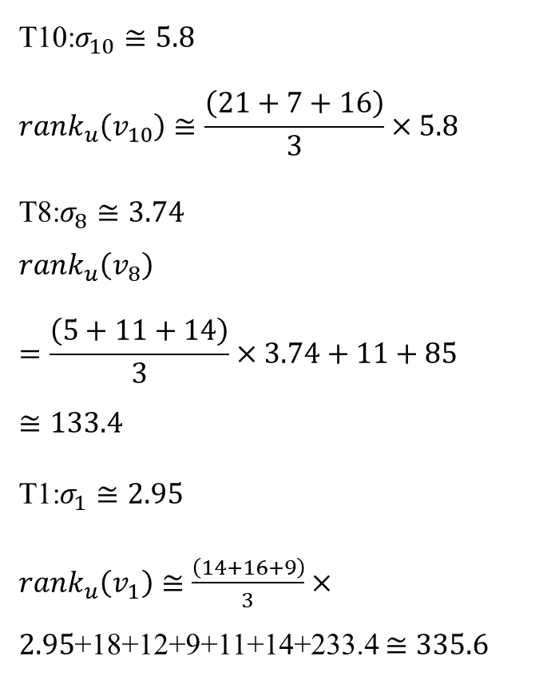
T10:$σ_{10}≅5.8$
$${rank}_{u}\left(v_{10}\right)≅\frac{\left(21+7+16\right)}{3}×5.8$$
T8:$σ_{8}≅3.74$
$${rank}_{u}\left(v_{8}\right)=\frac{\left(5+11+14\right)}{3}×3.74+11+85≅133.4$$
T1:$σ_{1}≅2.95$
${rank}_{u}\left(v_{1}\right)≅\frac{\left(14+16+9\right)}{3}×2.95$+18+12+9+11+14+233.4$≅335.6$
 | $$v_{1}$$ | $$v_{2}$$ | $$v_{3}$$ | $$v_{4}$$ | $$v_{5}$$ | $$v_{6}$$ | $$v_{7}$$ | $$v_{8}$$ | $$v_{9}$$ | $$v_{10}$$
$${rank}_{u}\left(v_{i}\right)$$ | 335.6 | 233.4 | 209.6 | 229.1 | 182.2 | 184.7 | 137.9 | 133.4 | 154.6 | 85.0

Slide 13
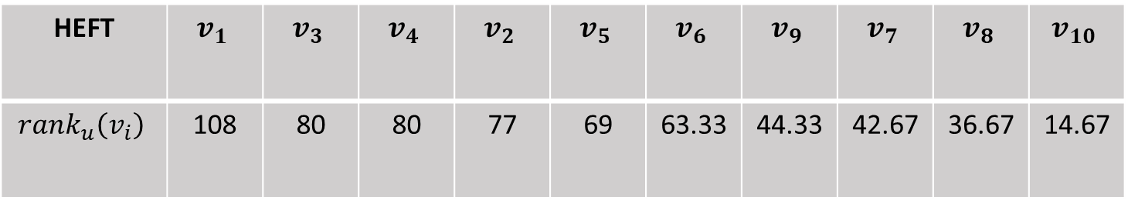
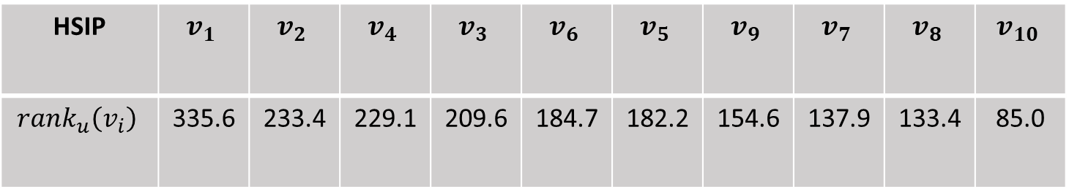
HSIP | $$v_{1}$$ | $$v_{2}$$ | $$v_{4}$$ | $$v_{3}$$ | $$v_{6}$$ | $$v_{5}$$ | $$v_{9}$$ | $$v_{7}$$ | $$v_{8}$$ | $$v_{10}$$
$${rank}_{u}\left(v_{i}\right)$$ | 335.6 | 233.4 | 229.1 | 209.6 | 184.7 | 182.2 | 154.6 | 137.9 | 133.4 | 85.0
HEFT | $$v_{1}$$ | $$v_{3}$$ | $$v_{4}$$ | $$v_{2}$$ | $$v_{5}$$ | $$v_{6}$$ | $$v_{9}$$ | $$v_{7}$$ | $$v_{8}$$ | $$v_{10}$$
$${rank}_{u}\left(v_{i}\right)$$ | 108 | 80 | 80 | 77 | 69 | 63.33 | 44.33 | 42.67 | 36.67 | 14.67

Slide 14
